Slide 1
Anomaly Detection in Grids POC Complete
20-Feb-2021

Slide 2
What Can Go Wrong with Tabular Data
Data internally inconsistent
Looking at the data, a human can tell you some subset of cells look wrong
Trade ID | Country | Currency
1 | USA | USD
2 | USA | USD
3 | USA | USD
4 | USA | USD
5 | USA | USD
6 | Germany | EUR
7 | Germany | EUR
8 | Germany | EUR
9 | Germany | USD
10 | Germany | EUR

Slide 3
How Can We Spot This?
Predict Every Cell, Compare
Observed
Predicted
Anomaly
Trade ID | Country | Currency
1 | USA | USD
2 | USA | USD
3 | USA | USD
4 | USA | USD
5 | USA | USD
6 | Germany | EUR
7 | Germany | EUR
8 | Germany | EUR
9 | Germany | USD
10 | Germany | EUR
Trade ID | Country | Currency
1 | USA | USD
2 | USA | USD
3 | USA | USD
4 | USA | USD
5 | USA | USD
6 | Germany | EUR
7 | Germany | EUR
8 | Germany | EUR
9 | Germany | EUR
10 | Germany | EUR
Trade ID | Country | Currency
1
2
3
4
5
6
7
8
9 |  | true
10

Slide 4
How Do We Do This?
For every column ‘c’, we train a classifier / regressor model on the entire dataset such that the other columns are the inputs ‘x’ and the output ‘y’ is the column ‘c’.
We then predict column ‘c’ for each row.
Model 1
Model 2
Input Columns
Output Column
Input Columns
Output Column
Trade ID | Country |  | Currency
1 | USA |  | USD
2 | USA |  | USD
3 | USA |  | USD
4 | USA |  | USD
5 | USA |  | USD
6 | Germany |  | EUR
7 | Germany |  | EUR
8 | Germany |  | EUR
9 | Germany |  | EUR
10 | Germany |  | EUR
Trade ID | Currency |  | Country
1 | USD |  | USA
2 | USD |  | USA
3 | USD |  | USA
4 | USD |  | USA
5 | USD |  | USA
6 | EUR |  | Germany
7 | EUR |  | Germany
8 | EUR |  | Germany
9 | EUR |  | Germany
10 | EUR |  | Germany

Slide 5
How Do We Do This?
We also need to know how certain our predictions are. There’s no point saying ‘A’ should be ‘B’ if ‘B’ is a random guess. Here, we should say just ‘A’ looks wrong.
We run our models N times (e.g. N=10) with a different subset of the rows to establish a variance for each prediction.
Full Dataset
Model 1 Run 1
Model 1 Run 2
Input Columns
Output Column
Trade ID | Country |  | Currency
1 | USA |  | USD
2 | USA |  | USD
3 | USA |  | USD
4 | USA |  | USD
5 | USA |  | USD
6 | Germany |  | EUR
7 | Germany |  | EUR
8 | Germany |  | EUR
9 | Germany |  | USD
10 | Germany |  | USD
Trade ID | Country |  | Currency
1 | USA |  | USD
2 | USA |  | USD
4 | USA |  | USD
6 | Germany |  | EUR
7 | Germany |  | EUR
8 | Germany |  | EUR
Trade ID | Country |  | Currency
1 | USA |  | USD
3 | USA |  | USD
4 | USA |  | USD
8 | Germany |  | EUR
9 | Germany |  | USD
10 | Germany |  | USD

Slide 6
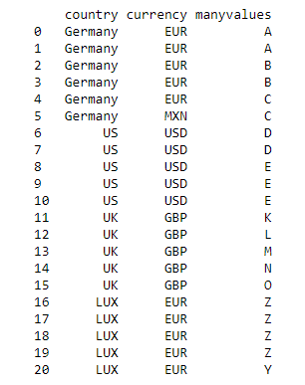
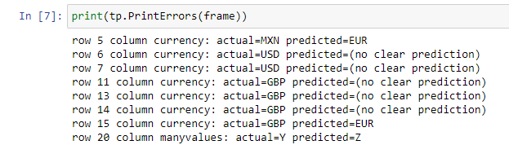
Non-Numeric Results

Slide 7
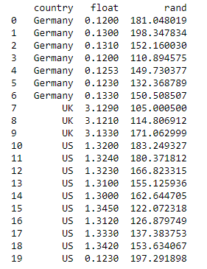







Numeric Results

